Slide 1

Visual OS Scheduler
Team
Sheikh Abdul Basit
Arslan Nawaz
Talal Riaz Khan

Slide 2
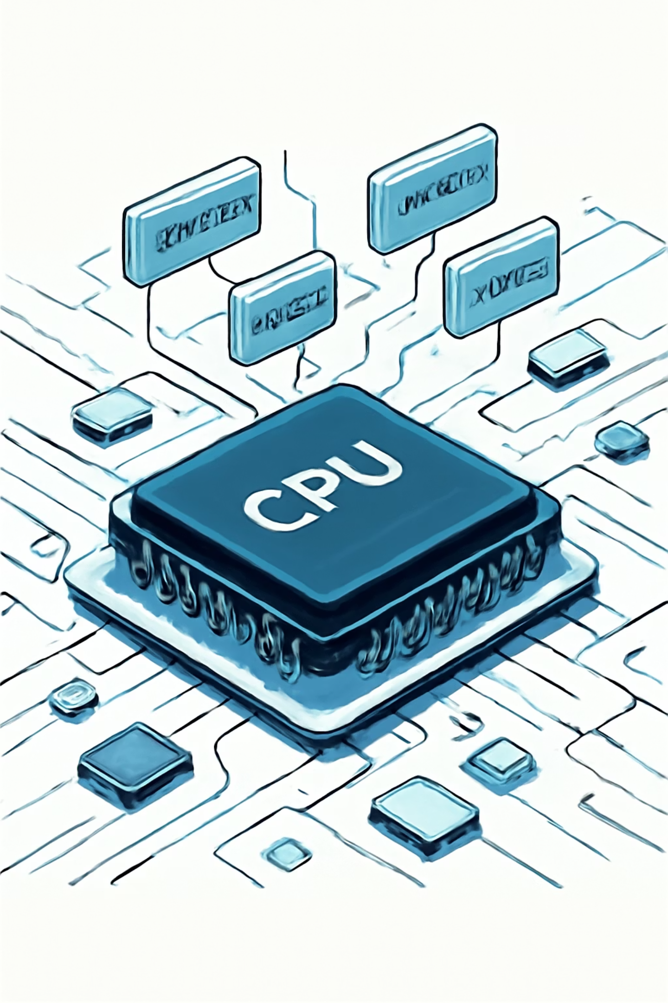
Overview
CPU scheduling decides which process runs when. It shapes process execution order and overall system performance.
Purpose
Maximize CPU utilization and responsiveness.
Impact
Affects waiting time, turnaround time, and fairness.

Slide 3

Problem
Contention
Multiple processes compete for a single CPU.
Goals
Need fairness and efficiency in scheduling.
Visualization
Scheduling behavior is hard to visualize and compare.

Slide 4
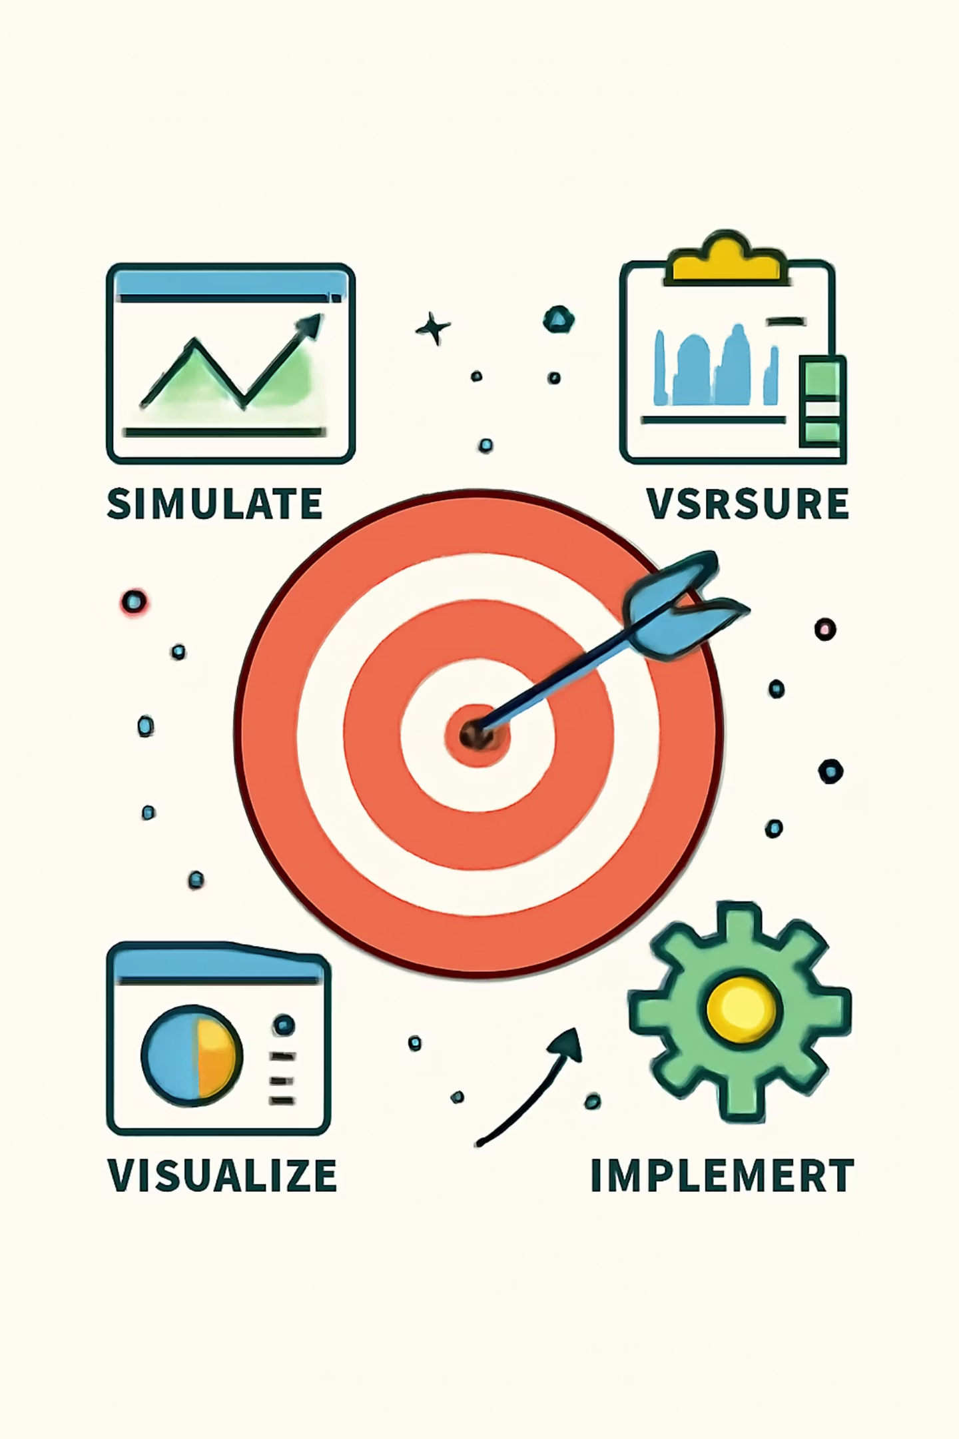
Objective
Implement scheduling algorithms
Simulate process execution
Visualize scheduling timeline
Measure performance metrics

Slide 5
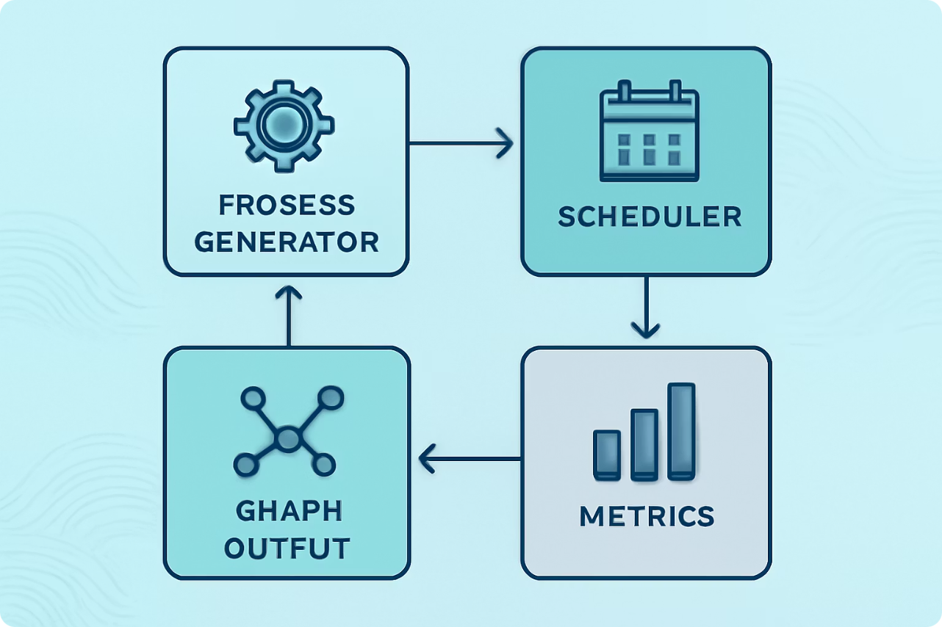
Project Structure
Process Generator
Scheduler Module
Creates input process sets
Applies selected algorithm
Graph & Metrics
Produces timeline and performance stats

Slide 6

Process Generator
Arrival time: Normal distribution
Burst time: Normal distribution
Priority: Poisson distribution
Generates varied realistic workloads for simulation.

Slide 7


Scheduler Module
Read Input
Reads file input, applies chosen algorithm, handles context switches, and outputs execution graph plus metrics.
Parse Processes
Supports configurable context-switch time and time quantum.
Select Algorithm
Simulate & Output

Slide 8
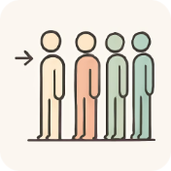


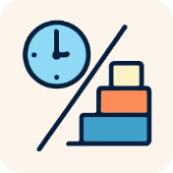
Algorithms Implemented
FCFS
HPF
Round Robin
SRTN
First Come First Serve — non-preemptive; simple but higher waiting time.
Priority-based — higher priority runs first; ties by process ID.
Time-sharing with quantum — fair scheduling.
Preemptive shortest remaining time first fast response.

Slide 9
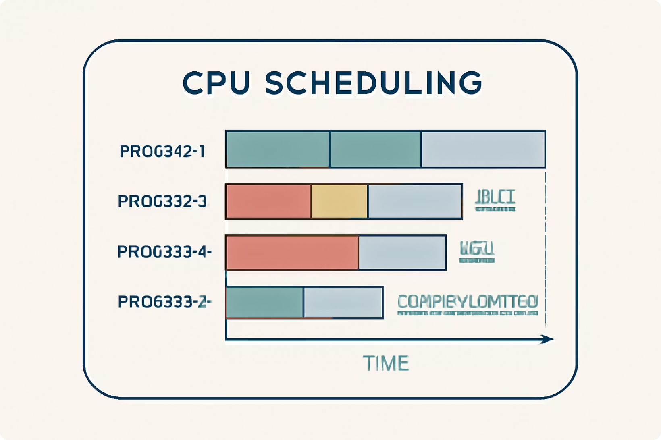
Input & Output
Input (file)
Process ID, Arrival Time, Burst Time, Priority
Output
CPU scheduling graph (timeline)
Waiting Time, Turnaround Time, Weighted Turnaround

Slide 10
Conclusion & Next Steps
Results
Challenges
Takeaway
All algorithms implemented; visualization and metrics working.
Preemption logic, context switching, and plotting timing correctly.
Built a working simulator , learned scheduling trade-offs and visualization techniques.

Slide 11

Any Questions?

